Slide 1

DIGITAL LOCK
Advanced Digital Logic Design
(17EVEC710)
Review Presentation
Presented by :
Jamuna Chavadi
01FE21MVE003
Under the guidance of :
Professor Name : Dr. Saroja V. Siddamal
School of Electronics and Communication Engineering
KLE Technological University, Hubballi

Slide 2
Contents
Objective
What is a digital lock?
Why use digital locks?
Flowchart
Data Path
Control Path
FSM State Diagram
Block Diagram
References

Slide 3
Objective
To design and implement a digital lock with 4-bit password.

Slide 4
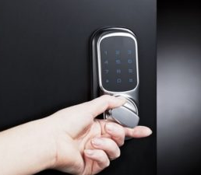
What is a digital lock?
Electronic/Digital locks are electronic or battery-operated locks that do not require the use of physical keys for access.
They are used as an alternative to the conventional mechanical locks, with the automated features giving a more creative security solution depending on its intended use.
Digital locks use a latch or bolt and use any of the following: RFIDs, pin codes, fingerprints, smartphones, and more.

Slide 5
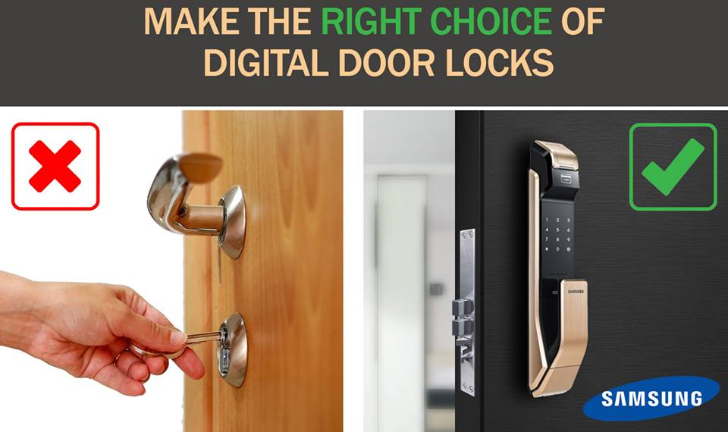
Why use digital locks?
Generally more economical, with no need for any physical keys (except for RFIDs that may need keycards).
They can also keep records of who accessed which locker at what time.
Multiple access solutions.
Alarm integration.
Tamper-proof integration.

Slide 6
Flowchart
INITIAL CONDITIONS
SET PASSWORD = 1101
UNSUCCESSFUL ATTEMPT = 000
UNLOCK = 0 ALARM = 0
START
ENTER PASSWORD
INCREMENT UNSUCCESSFUL ATTEMPT BY 1
COMPARE ENTERED CODE WITH SET CODE
NOT EQUAL
EQUAL
COMPARE UNSUCCESSFUL ATTEMPT WITH 3
GREATER THAN 3
UNLOCK = 1
STOP
ALARM = 1
LESS THAN OR EQUAL TO 3

Slide 7
Data Path
BUS
LDEP
[3:0] ENTERED PASSWORD
[3:0] SET PASSWORD
CLEP
DATA_IN
X
Y
COMPARATOR
EP:SP
NOT_EQUAL
COUNTER
INCREMENT UA BY 1
INCC
EQUAL
UNLOCK = 1
ALARM = 0
COMPARATOR
UA <= 3
GT
LTE
UNLOCK = 0
ALARM = 1
STOP
ALARM = 1

Slide 8
Control Path
START = 1
ENTERED PASSWORD = DATA_IN
UA = UA + 1
COMPARE EP:SP
NOT EQUAL
EQUAL
GREATER THAN
COMPARE
UA <= 3
UNLOCK = 1
ALARM = 1
LESS THAN OR EQUAL
STOP
DONE = 1

Slide 9
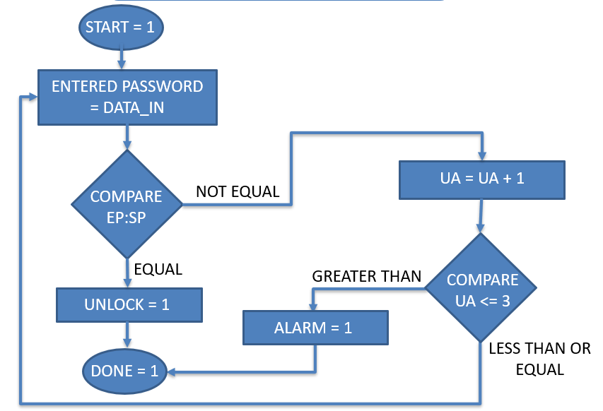
FSM State Diagram
S0
S1
NEQ
S2
S5
EQ
LTE
S3
S6
GT
S4
S7

Slide 10
Block Diagram
LDEP
DATA PATH
CONTROL PATH
CLEP
INCC
DATA_IN
EQUAL
NOT_EQUAL
LTE
START
AND
GT
DONE
CLK

Slide 11
References
Ciletti MD, “Advanced Digital Design with the Verilog HDL”, New Jersey: Pearson Education, 2003.
Murtala Zungeru Adamu, “An electronic digital combination lock: A precise and reliable security system”, International Journal of Security Privacy and Trust Management, DOI: 10.5121/ijsptm.2013.2103, 2013.

Slide 12
THANK YOU

